Slide 1
LAVENIR METAL COATING LLC
A Fabrication and Coating Company
Modern Emirates Industrial Area
Umm Al Quwain
www.lavenirgrp.com
Branch:
DIP-2
Dubai, UAE
LAVENIR DECOR SYSTEMS LLC
Modern Emirates Industrial Area
Umm Al Quwain
Many years of unparalleled service

Slide 2
A Fabrication and Coating Company
ABOUT US
Lavenir group comprises of Lavenir Metal Coating LLC and Lavenir Decor Systems LLC.
Lavenir Metal Coating provides Powder coating, Fabrication and Laser cutting services and
Lavenir Décor System provides Custom Wood Finish Coating services
Established in 2013 as a powder company in the Emirate of Umm Al Quwain, today we have expanded our services to SS and MS Fabrication works, Design laser cutting on pipes ,Tubes, sheets etc. and provides Quality custom finish wood grain coating works
Our Powder coating and fabrication services successfully serving customers who are into industries such as Sign Board, Handrails, Aluminium doors and Windows, Laboratory furniture, Super Market shelves ,AC Grilles and all kinds of Furniture
Our custom finish wood grain coating effects easily enhance the appearance of your product, doors, tables, chair or Kitchen Cabinets
The company is equipped with state of art facilities to undertake the above activities that includes fully automated powder coating oven, CNC Fiber Laser Cutting machine, Hydraulic Press brake, Hydraulic Shearing Machine etc

Slide 3
OUR VISION & MISSION
A Fabrication and Coating Company
We aim at providing the best service to customers on time by providing innovative, best quality and low price product/service and accomplish satisfying service
SATISFYING SERVICE
We believe that high level of customer satisfaction is a business goal for every Company and a key to success. We always welcome customer feedback and turn them into action
ON TIME AND SCHEDULE
On-Time Delivery shows the ability of the organization to meet customer expectations with respect to the time and is a key to customer satisfaction
INNOVATIVE, QUALITY, LOW PRICE
Being innovative and providing high Quality is the backbone of every business and at Lavenir we believe in providing the best to clients by never compromising on the quality of our service

Slide 4
A Fabrication and Coating Company
OUR SERVICES
01
POWDER COATING
02
WOOD FINISH COATING
03
PVC COATING
04
FABRICATION WORKS
05
DESIGN LASER CUTTING
06
OTHER SERVICES

Slide 5
METAL FABRICATION
A Fabrication and Coating Company
Metal fabrication is the creation of metal structure by cutting bending and assembly process. It is a value-added process involving the creation of structures, parts, specifically designed output from various materials
We are equipped with Hydraulic press break, Hydraulic Shearing machine and other machineries/tools and you can depend us for folding, bending, cutting, rolling, spinning, and finishing and we offer MIG or TIG welding on any alloy that can be welded
We have successfully fabricated for many projects requiring Handrails with/ without mesh using GI sheets/SS steel, Steel Enclosures with single cut open louvered door with lock, Cabinet shelves for supermarkets, Display units and many other works as per the prescribed drawings

Slide 6
DESIGN LASER CUTTING
A Fabrication and Coating Company
Laser cutting technology uses laser to slice materials. The laser optics and CNC (computer numerical control) are used to direct the material, or the laser beam generated leaving an edge with a high-quality surface finish.
We offer quality laser cutting services of all kinds of designs that can be applied on Mild Steel, Stainless Steel, Aluminium sheets, Pipes (Round and Square)

Slide 7
POWDER COATING
A Fabrication and Coating Company
Powder coating is a type of coating that is applied as a free-flowing, dry powder. Unlike conventional liquid paint which is delivered via an evaporating solvent, powder coating is typically applied electrostatically and then cured under heat and is eco friendly
Our conveyor used powder coating facility is capable to powder coat Aluminium Extrusions, Furniture’s including Lab furniture, Railings, Doors, Gates, Windows and many other components. We have Automatic and manual powder coating guns from world renowned GEMA, Switzerland. We use quality powder from Jotun Powder coatings and Akzo Nobel
Our Box oven facility can powder coat fabricated items that are up to 3m H x 2m W and 7 m Length
We cater to Aluminium & Metal Fabricators, Signage makers,
interior and Fit out contractors, contracting companies etc.

Slide 8
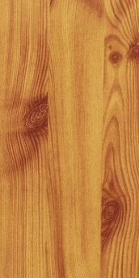
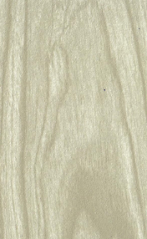
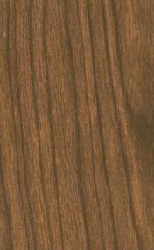
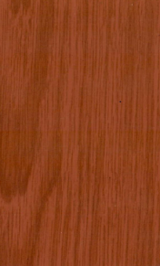
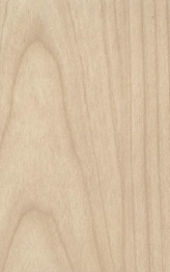
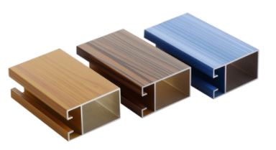
WOOD FINISH POWDER COATING
A Fabrication and Coating Company
Wood finish coating uses polyester films transferable on aluminum and preprinted metals, for the creation of refined wood- like aesthetic effects. Wood finish coating is environment friendly because the inks used on films are ecologically certified; while the decorations, wood effect on aluminum is good to replace the wood, preserving forests from deforestation
We offer quality custom finish wood grain coating works. The above applications can be decorated in any colour or design. Our custom finish wood grain coating effects easily enhance the appearance of the product
Most common uses for Wood grain decorative coating:
(i) Windows (extrusion) (ii) Aluminium Sheets, (iii) Doors and Garage Doors, (iv) Decorative Ceiling Tiles Pergola, (v) Benches, Tables, Chairs, etc. (vi) Decorative Decks and Railings, (vii) Kitchen Cabinets, Tops, Enclosures etc. (viii) Shelves, Displays, Counter tops and so on

Slide 9
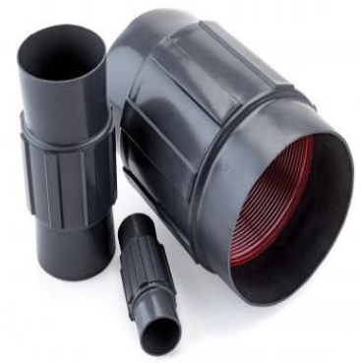
PVC COATING
A Fabrication and Coating Company
PVC powder coating is used on steel and aluminum in applications like corrosion, impact, and abrasion.
PVC Coated products are engineered to withstand harsh and corrosive environments to resist oils, grease, acids, alkalis, and moisture like in the petrochemical industry.
We offer PVC coating on various fittings in both galvanized, rigid steel and rigid aluminum fittings

Slide 10
OTHER SERVICES
A Fabrication and Coating Company
We also undertake the below jobs :-
Galvanizing
Sand blasting
and
Other maintenance jobs in super markets/departmental stores like Painting, Sliding door installation, fixing glass etc., Spray painting, and other jobs as per the requirement of the customer

Slide 11
WHY LAVENIR
A Fabrication and Coating Company
Years of hands on experience in serving the industry
Personnel but professional service
No Job is too small
Skilled force and Machinery to ensure timely delivery
Bespoke, Innovative, Quality & Low price
One stop service, own fleet to provide pick drop service

Slide 12
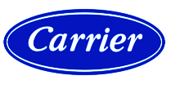
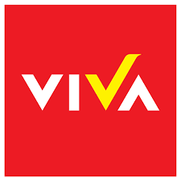
Clients and Suppliers
A Fabrication and Coating Company
Selected Clients
Selected Suppliers

Slide 13
SELECTED PROJECTS
A Fabrication and Coating Company

Slide 14
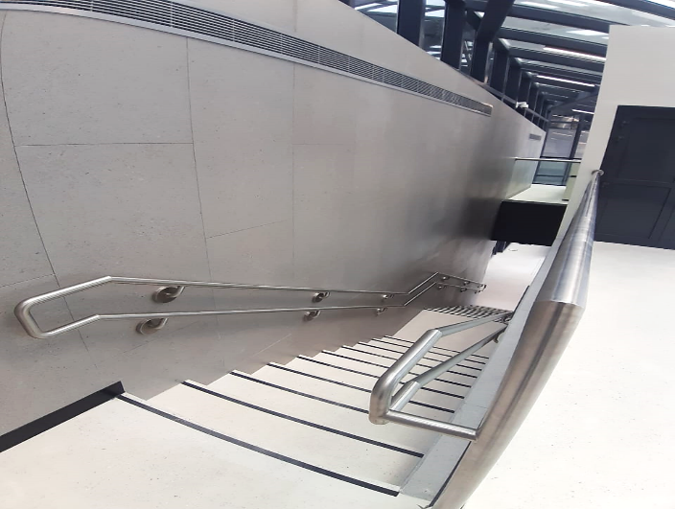
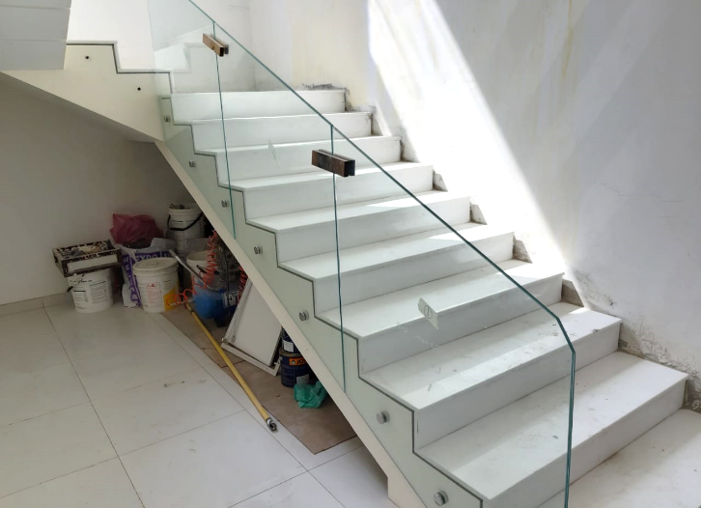
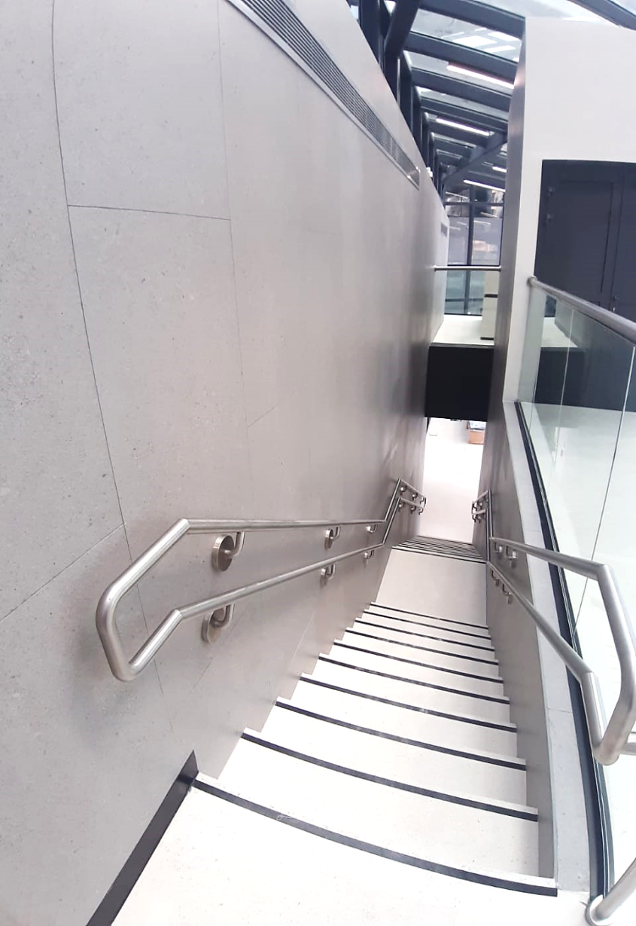
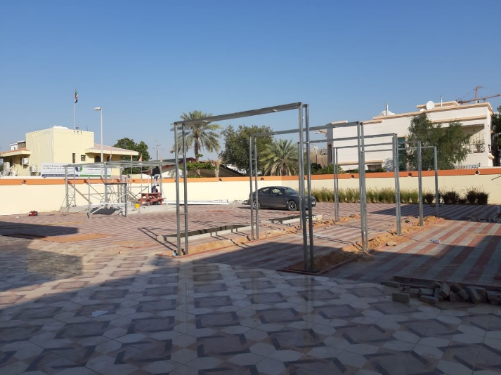
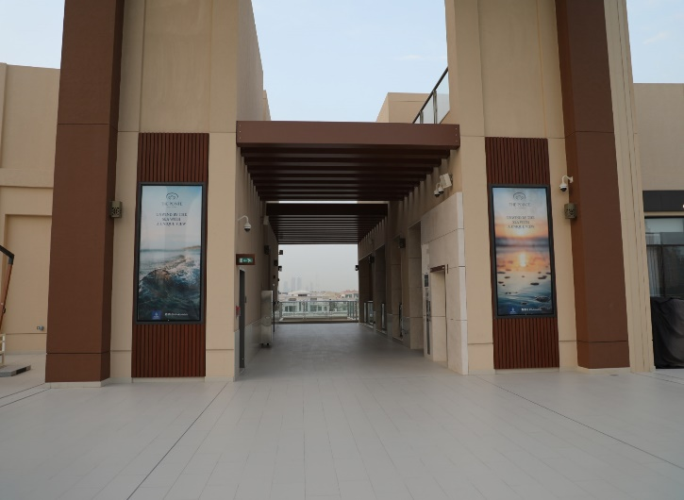
MAJOR PROJECTS IN PICTURES
A Fabrication and Coating Company
SS Handrails - Ghubaiba Bus Station
Handrails - Safina Tower
Pergolas - Jumeirah Villa
Wood Finish Coating –Pointe Dubai

Slide 15
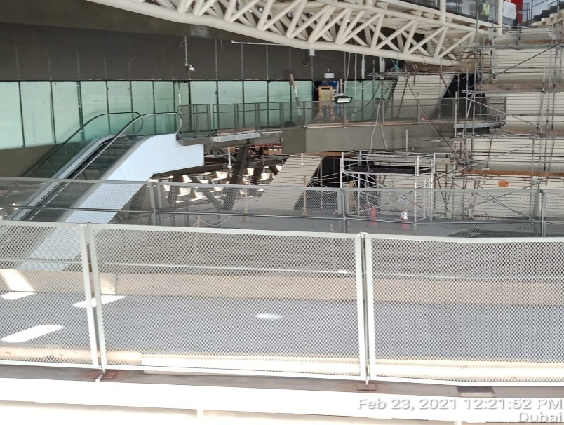
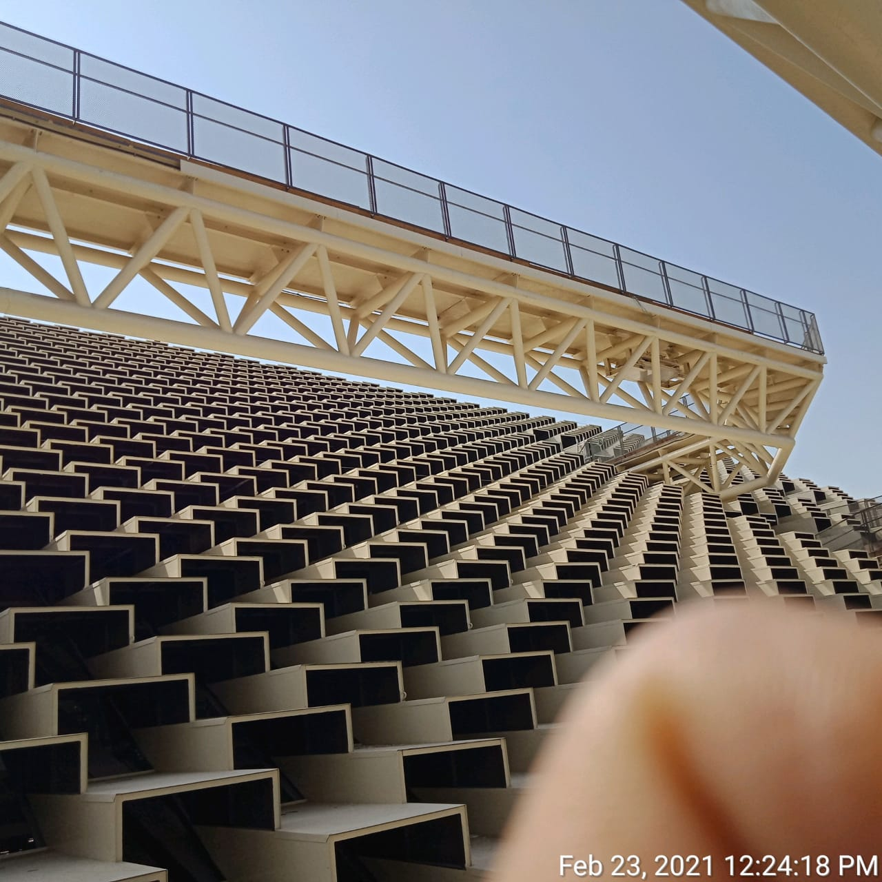
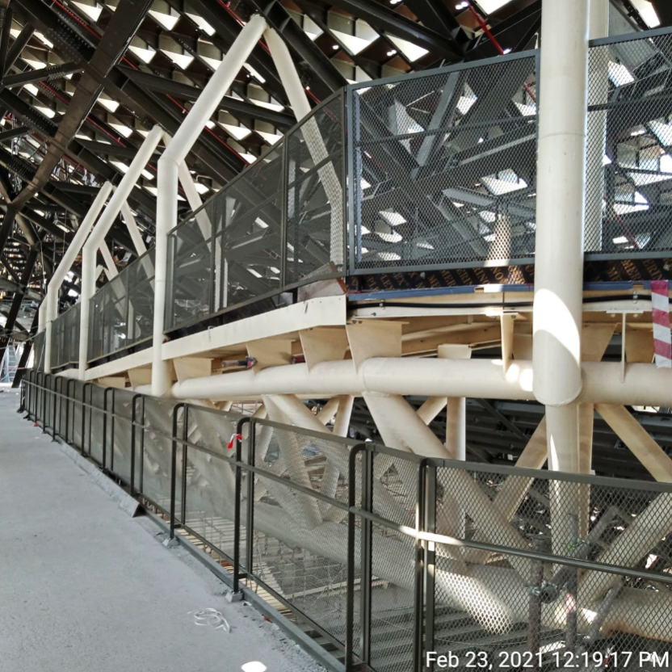
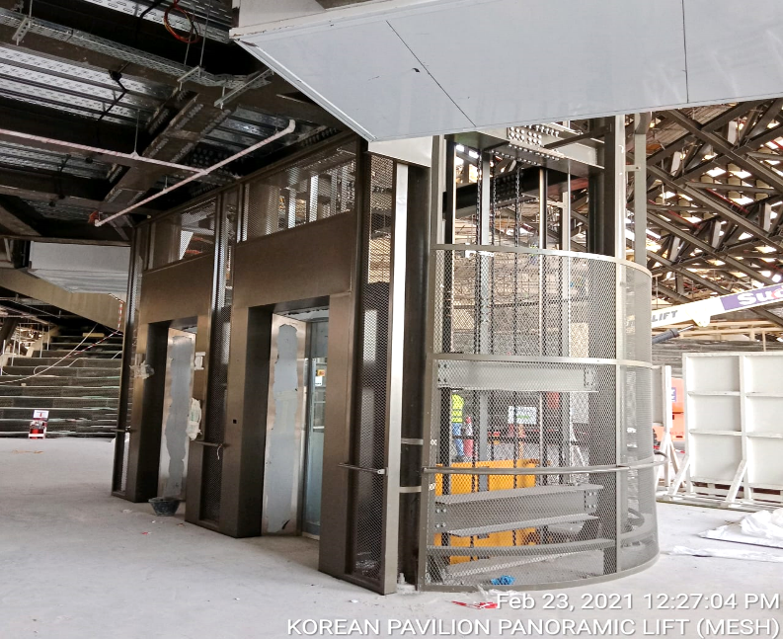
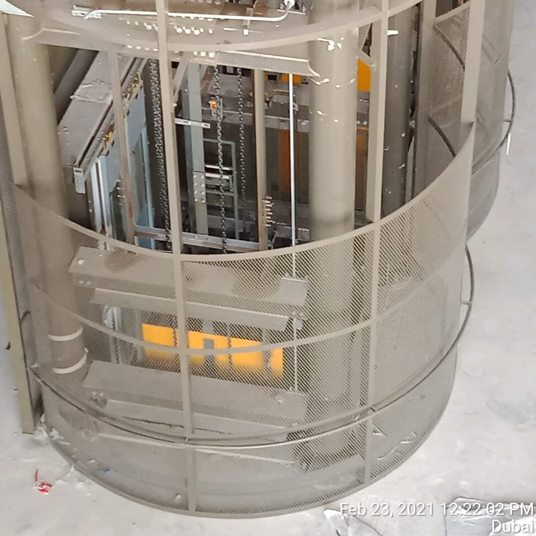
MAJOR PROJECTS IN PICTURES (KOREA PAVILLION EXPO-2020
A Fabrication and Coating Company
Fabrication and supply of GI Handrail with Mesh for Staircase and ramp areas, SS cladding for elevator, Fabrication and supply of Aluminium flash etc.

Slide 16
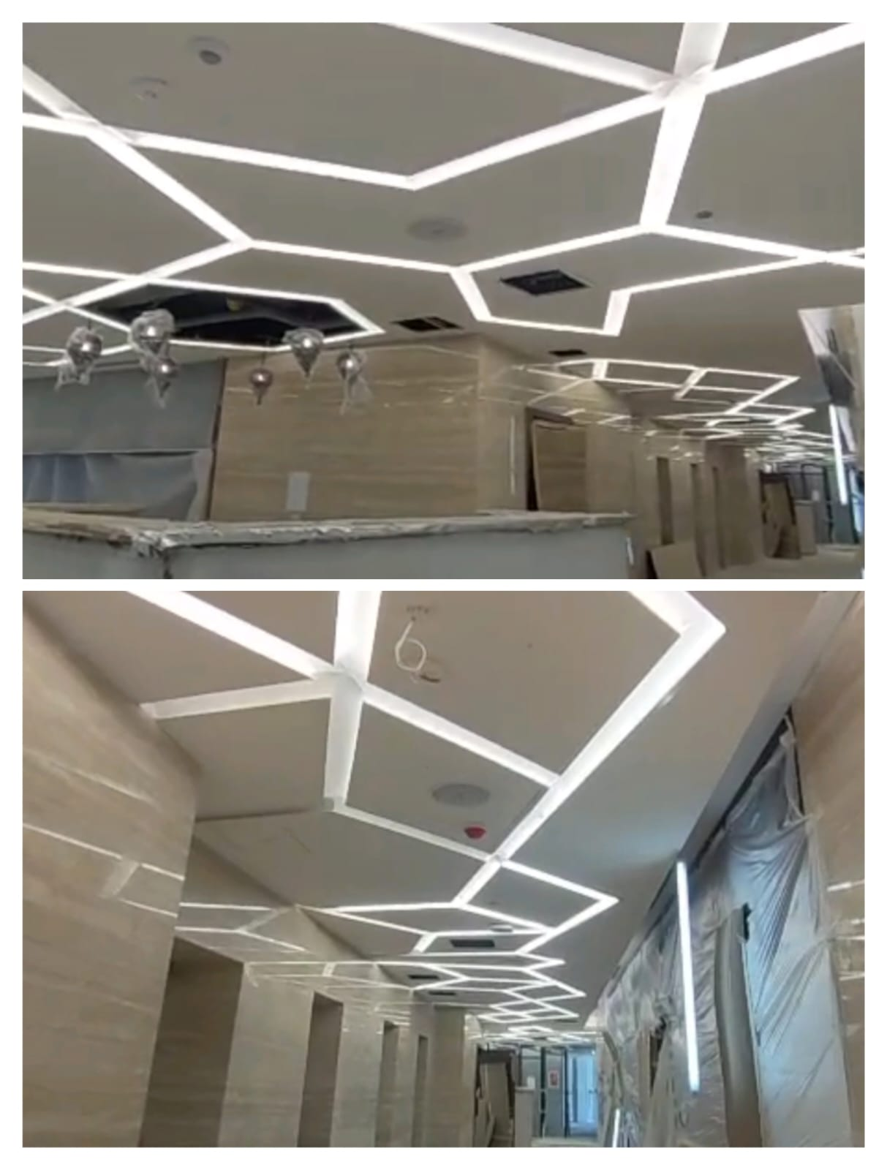
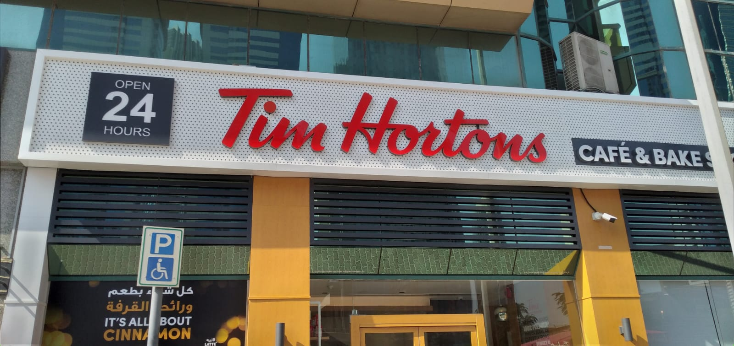
PROJECTS IN PICTURES
A Fabrication and Coating Company
Fabrication and Supply of perforated sheets for Sign Board installation and Wood finish cladding at Tim Hortons at Tower 1, Dubai
Design, supply, and supervision of installation of ALUMINIUM PROFILE FOR LIGHT FIXTURE at 1075-EREC BUILDING, Muhaisnah For Airolink Contracting

Slide 17
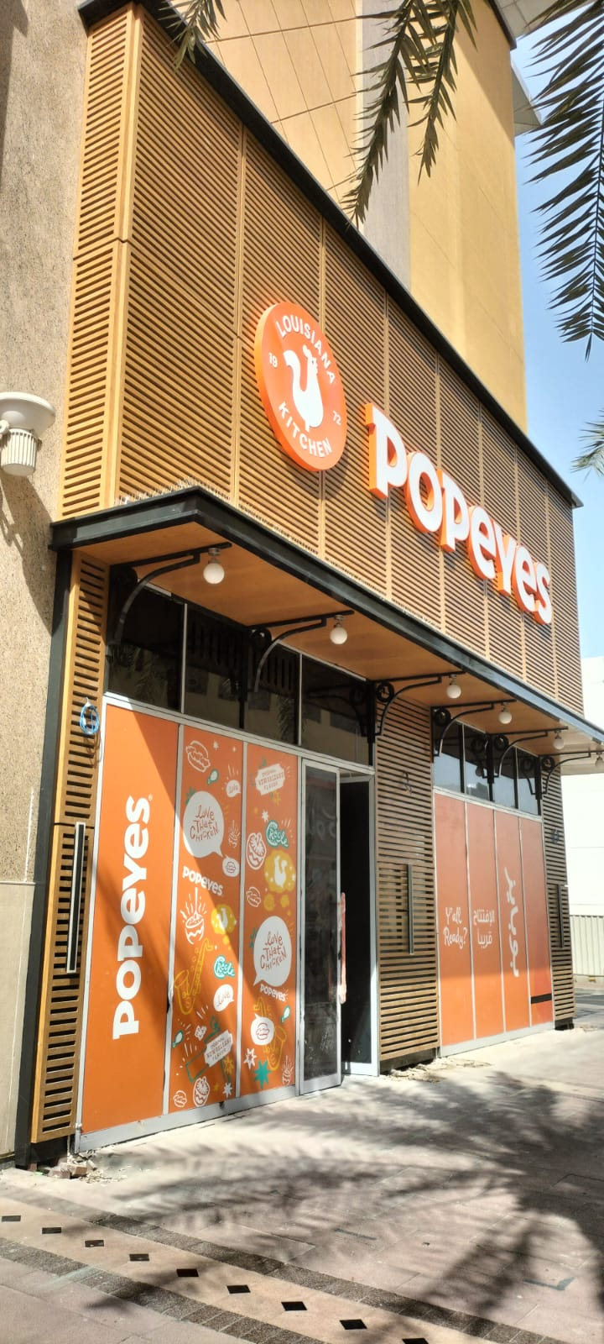
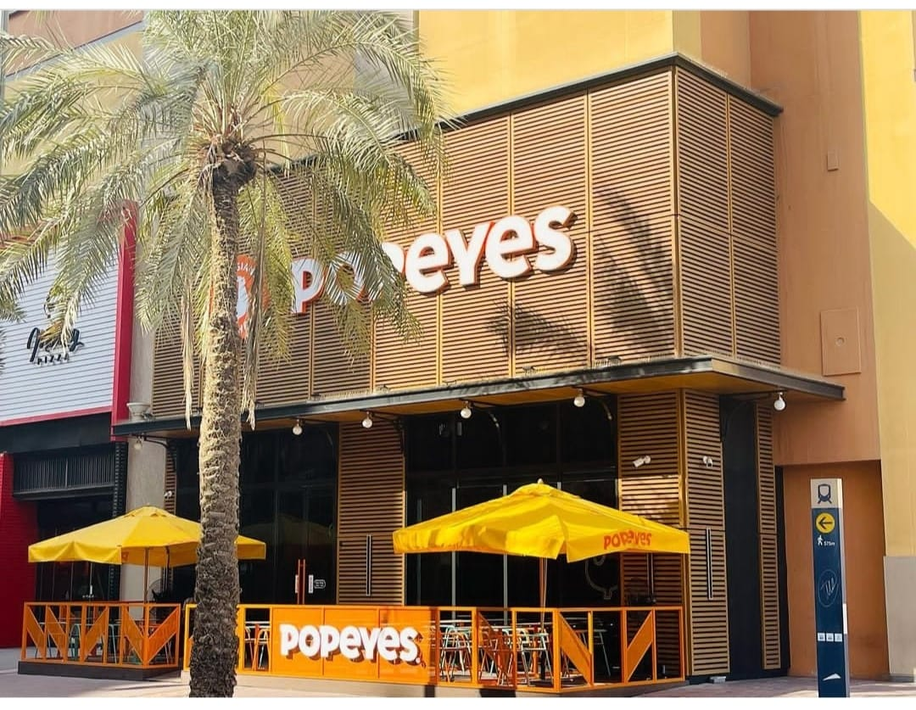
PROJECTS IN PICTURES
A Fabrication and Coating Company
Wood finish cladding works and shop front works for Popeyes Chicken at Al Ghurair Mall

Slide 18
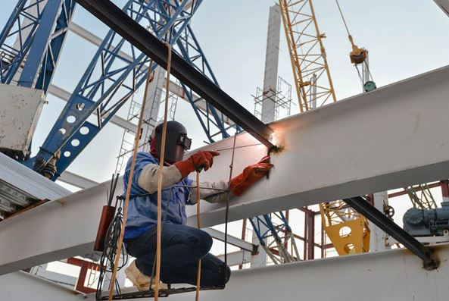
STAY WITH US
laveniruaq@gmail.com
www.lavenirgrp.com
Modern Emirates Industrial Area
Umm Al Quwain, United Arab Emirates
Tel:+971 6 7671014
Branch: DIP 2,Dubai

